Slide 1
Pub ou réalité?

Slide 2
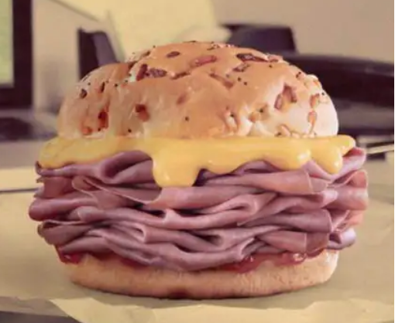
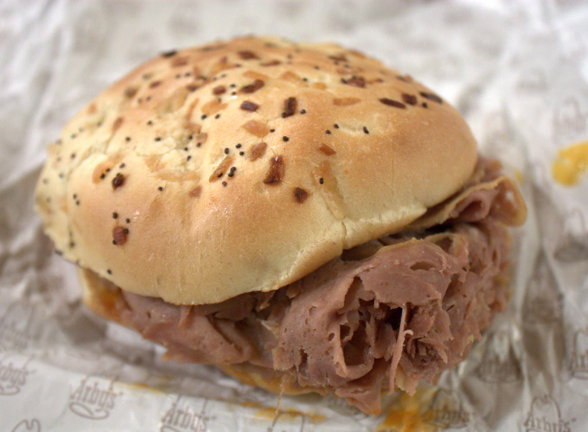
PUB
RÉALITÉ
Notes:
Which of these photos is real, and which is from an ad?
When students have made their guess, click to reveal the answer.

Slide 3
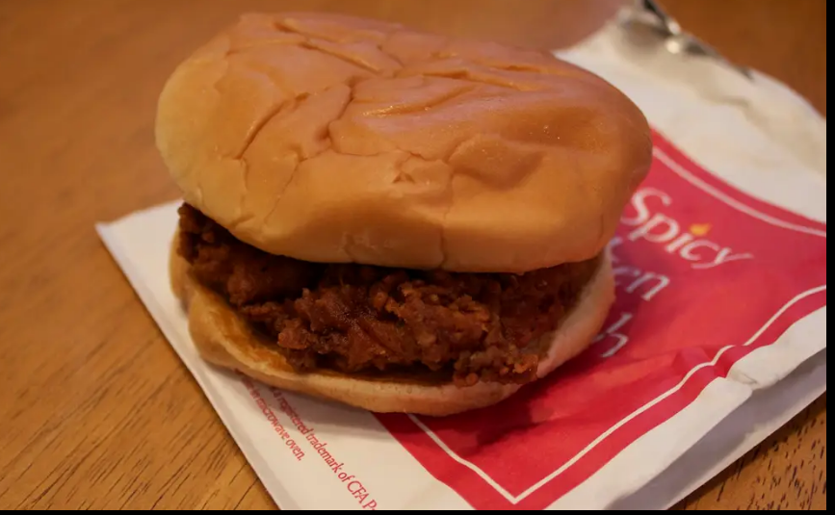
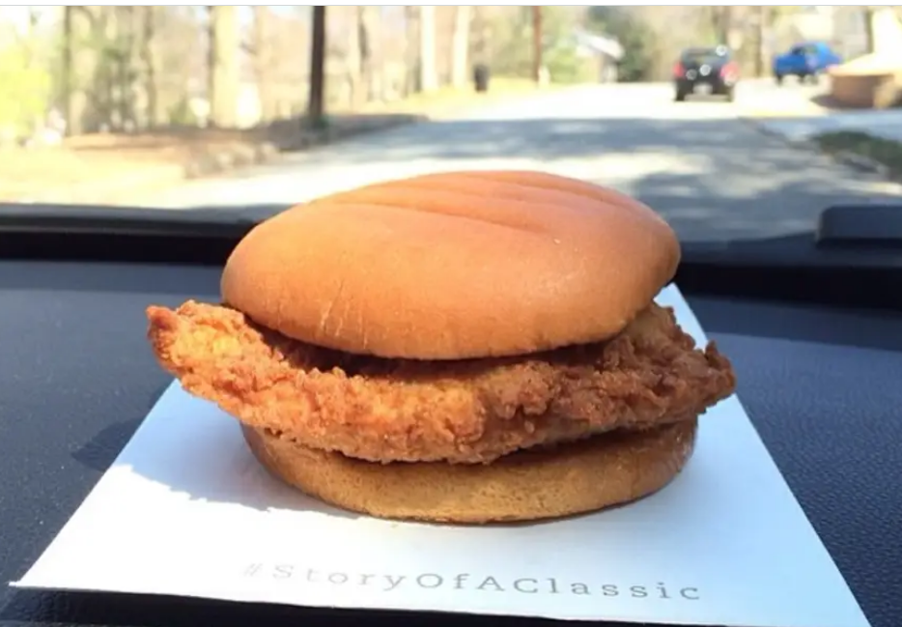
RÉALITÉ
PUB
Notes:
When students have made their guess, click to reveal the answer.

Slide 4
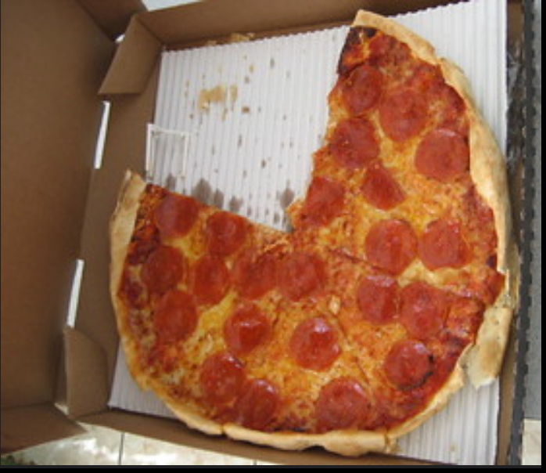
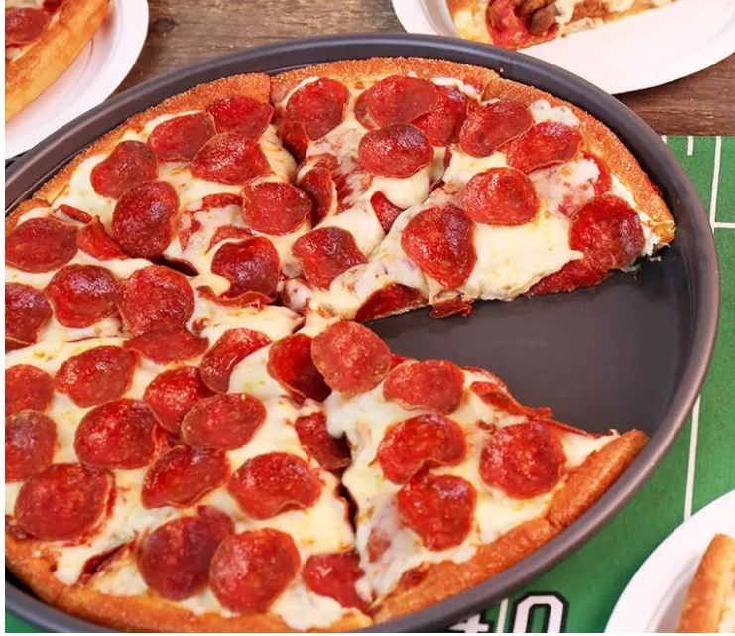
RÉALITÉ
PUB
Notes:
When students have made their guess, click to reveal the answer.

Slide 5
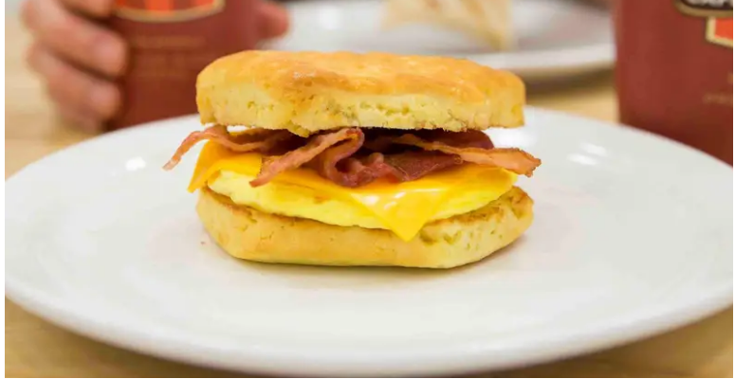
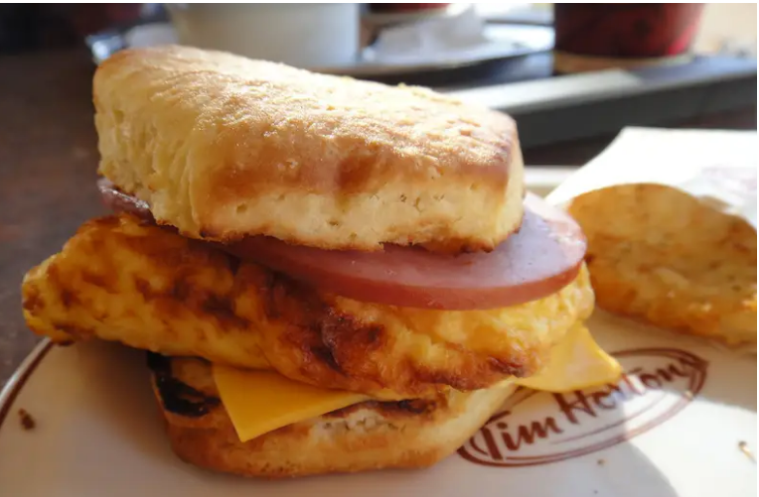
PUB
RÉALITÉ
Notes:
When students have made their guess, click to reveal the answer.

